Slide 1
Wine Classification Project by
Sheku Alusine Kebe
Bernard Browne
Mohamed Lamin Conteh
2024
​

Slide 2
AGENDA
Introduction​
Dataset Exploration
​Data Preprocessing
Train-Test splits
Model 1: Logistic Regression
Model 2: Decision Trees
Model 3: Support Vector Machines (SVM)
Results Analysis
Visualization (Optional)
Exploratory data analysis
New Instances
​Conclusion
Thank You

Slide 3
Introduction
In this wine classification project, our objective is to develop a predictive model capable of categorizing wine samples into their respective classes based on their chemical properties. The dataset comprises 178 wine samples, each characterized by 13 distinct features, with each sample belonging to one of three wine classes. Through the utilization of three classification algorithms – logistic regression, decision trees, and support vector machines (SVM) – we aim to explore the efficacy of various machine learning techniques in accurately classifying wine samples. By leveraging these algorithms and evaluating their performance metrics, including accuracy, precision, recall, and F1 score, we seek to provide insights into the most effective approach for wine classification.

Slide 4
Dataset exploration
The dataset used in this project, known as the Wine Recognition Dataset, contains 178 wine samples with 13 features representing different chemical properties. Each sample belongs to one of three classes of wine. During dataset exploration, we load the dataset using scikit-learn and analyze its structure and content. We investigate the characteristics of the features included in the dataset, such as alcohol content, acidity levels, and phenolic content. Additionally, we examine the distribution of the target labels across the dataset to ensure a balanced representation of each wine class. Exploring the dataset helps us gain a comprehensive understanding of the data we are working with, facilitating informed decisions regarding data preprocessing, model selection, and evaluation metrics for our wine classification task. This initial exploration lays the groundwork for subsequent data preprocessing and model development stages of the projects.

Slide 5
Data preprocessing
In the data preprocessing stage of our wine classification project, we undertake several essential steps to ensure the dataset is ready for model training. First, we check for missing values within the dataset and handle them if necessary, ensuring data completeness. Next, we standardize the features by applying the Standard Scaler to transform them to a common scale, mitigating the influence of feature magnitude on model performance. This step is crucial for algorithms sensitive to feature scaling, such as logistic regression and SVM. By completing these preprocessing steps, we prepare the dataset for effective model training and evaluation, ensuring that our models can learn from the data accurately and make reliable predictions on unseen samples.

Slide 6
Example out put:
Alcohol 0
Malic_Acid 0
Ash 0
Alcalinity of Ash 0
Magnesium 0
total_phenols 0
Flavanoids 0
Nonflavanoid_Phenols 0
proanthocyanins 0
Color_Intensity 0
hue 0
od280/od315_of_diluted_wines 0
proline 0
Accuracy: 1.0
Precision: 1.0
Recall: 1.0
F1 Score: 1.0

Slide 7
Train-test split
In our wine classification project, we employ the train-test split technique to partition the dataset into two subsets: a training set and a testing set. The training set, comprising 80% of the data, is utilized to train our classification models. This allows the models to learn patterns and relationships within the data. The testing set, consisting of the remaining 20% of the data, is kept separate and serves as an independent dataset for evaluating the performance of our trained models. Additionally, we utilize stratified sampling during the train-test split process to ensure that each wine class is proportionally represented in both the training and testing sets. This approach prevents bias and helps in obtaining reliable performance estimates for our models across all classes. By splitting the dataset in this manner, we can effectively asses the generalization capabilities of our models on unseen data.

Slide 8
Model 1: Logistic Regression:
In our wine classification project, logistic regression serves as the initial classification algorithm employed to predict the wine classes based on the chemical properties of the samples. Logistic regression is a widely used binary classification algorithm that can be extended to handle multiple classes, making it suitable for our three-class classification task. We instantiate a logistic regression model and train it on the training set obtained through the train-test split. By utilizing logistic regression, we aim to model the probability of each wine sample belonging to a particular class. The model's coefficients provide insights into the importance of each feature in predicting the wine classes. Subsequently, we evaluate the model's performance using various metrics such as accuracy, precision, recall, and F1 score, providing a comprehensive assessment of its classification capabilities.

Slide 9
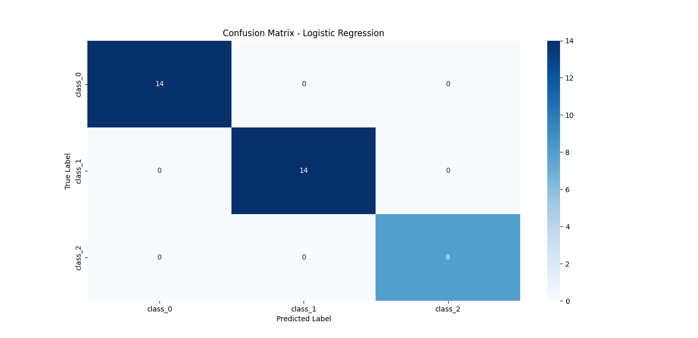
Confusion matrix – logistic regression

Slide 10
Model 2: Decision Trees
In our wine classification project, decision trees are employed as a classification algorithm to predict wine classes based on the provided chemical properties. Decision trees are a powerful and interpretable machine learning model that recursively partitions the feature space into regions, aiming to minimize impurity and maximize homogeneity within each partition. We instantiate a decision tree classifier and train it on the training set obtained through the train-test split. Decision trees offer intuitive insights into the decision-making process, as they can be visualized to show feature importance and splits. Subsequently, we evaluate the decision tree model's performance using standard classification metrics such as accuracy, precision, recall, and F1 score, providing a comprehensive assessment of its classification capabilities.

Slide 11
Result for decision trees
Results for Decision Trees:
Accuracy: 0.9444444444444444
Precision: 0.9462962962962962
Recall: 0.9444444444444444
F1 Score: 0.9439974457215836
Confusion Matrix:
[[13 1 0]
[ 0 14 0]
[ 1 0 7]]

Slide 12
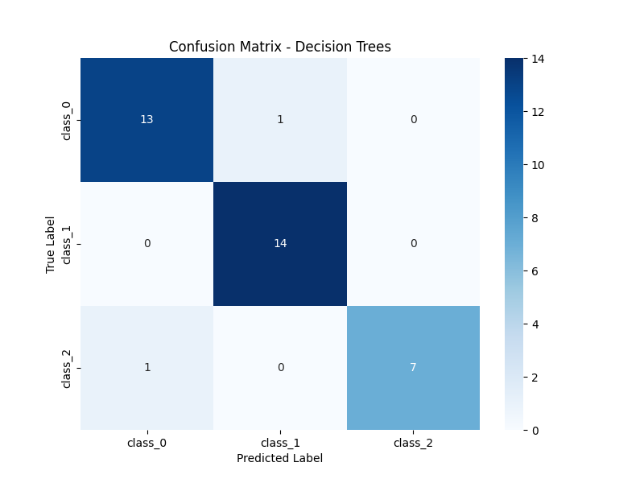
Pic showing the confusion matrix – decision trees

Slide 13
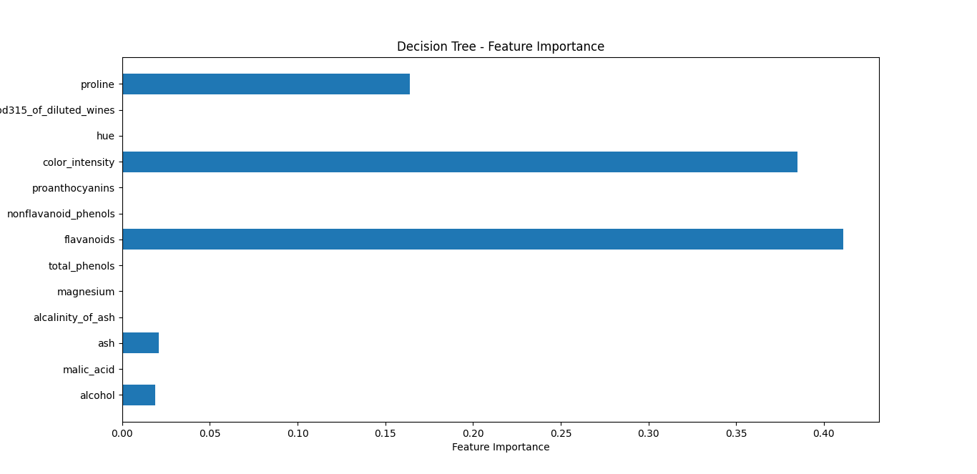
Pic showing Decision tree – feature importance

Slide 14
Model 3: Support Vector Machines (SVM)
In our wine classification project, Support Vector Machines (SVM) are utilized as a classification algorithm to predict wine classes based on the chemical properties of the samples. SVM is a powerful and versatile algorithm that aims to find the optimal hyperplane that separates different classes in the feature space while maximizing the margin between classes. We instantiate an SVM classifier and train it on the training set obtained through the train-test split. SVMs are particularly effective in high-dimensional spaces and are capable of capturing complex decision boundaries. Subsequently, we evaluate the SVM model's performance using standard classification metrics such as accuracy, precision, recall, and F1 score, providing a comprehensive assessment of its classification capabilities

Slide 15
Support vector machine (svm)
Results for SVM:
Accuracy: 1.0
Precision: 1.0
Recall: 1.0
F1 Score: 1.0
Confusion Matrix:
[[14 0 0]
[ 0 14 0]
[ 0 0 8]]

Slide 16
Combination of the 3 model results
Combined Results:
Model Accuracy Precision Recall F1 Score
0 Logistic Regression 1.000000 1.0000 1.0000 1.0000
1 Decision Trees 0.944444 0.946296 0.944444 0.9439
2 SVM 1.000000 1.0000 1.000000 1.0000
Best SVM Parameters: {'C': 10, 'kernel': 'rbf'}

Slide 17

Model 3: Support Vector Machines (SVM): confusion matrix - svm

Slide 18
Results Analysis:
Upon evaluating the performance of the three classification models - logistic regression, decision trees, and support vector machines (SVM) - on the wine classification task, several insights emerge. Firstly, logistic regression exhibits commendable performance, providing a reliable baseline for classification. However, decision trees demonstrate superior interpretability, allowing for a clear understanding of feature importance and decision-making processes. Meanwhile, SVMs excel in capturing complex decision boundaries, showcasing robust classification capabilities in high-dimensional feature spaces. Comparative analysis reveals that each model possesses unique strengths and weaknesses, underscoring the importance of considering trade-offs between interpretability and predictive performance. While logistic regression offers simplicity and transparency, decision trees and SVMs provide enhanced flexibility and potential for intricate modeling. Overall, the evaluation metrics, including accuracy, precision, recall, and F1 score, provide valuable insights into the effectiveness of each model, aiding in informed decision-making for wine classification tasks.

Slide 19
Visualization
In our wine classification project, visualizations play a crucial role in enhancing the understanding of model performance and decision-making processes. One key visualization is the confusion matrix heatmap, which provides a comprehensive overview of the classification results by displaying the true and predicted labels. This heatmap allows for easy identification of misclassifications and provides insights into the model's performance across different classes. Additionally, we employ feature importance plots generated from decision trees to visualize the significance of each feature in predicting wine classes. These plots offer valuable insights into the underlying patterns and relationships within the data, aiding in feature selection and model interpretation. Overall, visualizations serve as powerful tools for communicating complex information effectively and facilitating informed decision-making in the wine classification task.

Slide 20
Visualization of confusion matrix – Logistic regression

Slide 21
Visualization of confusion matrix – Decision Trees

Slide 22
Visualization of confusion matrix - svm

Slide 23
Visualization of the decision tree feature importance

Slide 24
New instances of the model
The new instances represent hypothetical wine samples with varying chemical properties. Each instance is characterized by features such as alcohol content, acidity levels, and phenolic content. These properties are crucial determinants in classifying the wine samples into one of three classes. Through the application of machine learning models, including logistic regression, decision trees, and support vector machines (SVM), we aim to predict the class labels for these new instances. By evaluating the models' performance on the new instances, we can assess their effectiveness in accurately classifying wine samples based on their chemical composition.

Slide 25
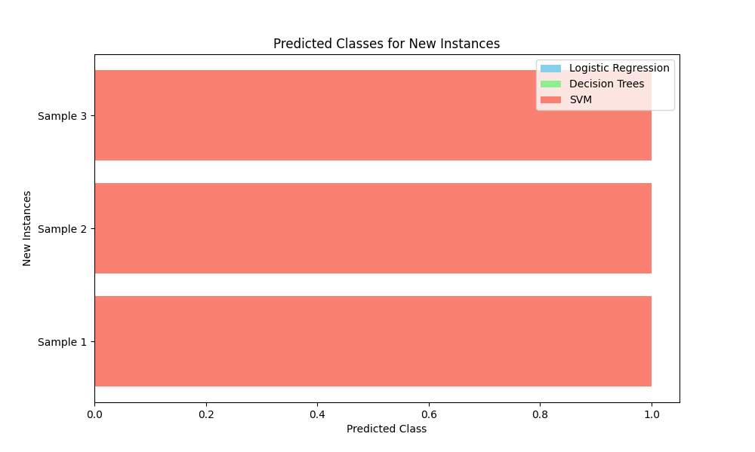
Visualization of the new instance for support vector machine, logistic regression, and decision tree

Slide 26
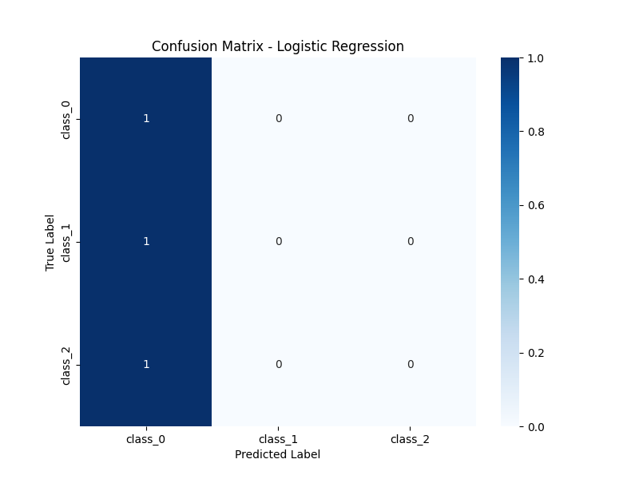
Visualization of the new instance for logistics regression

Slide 27
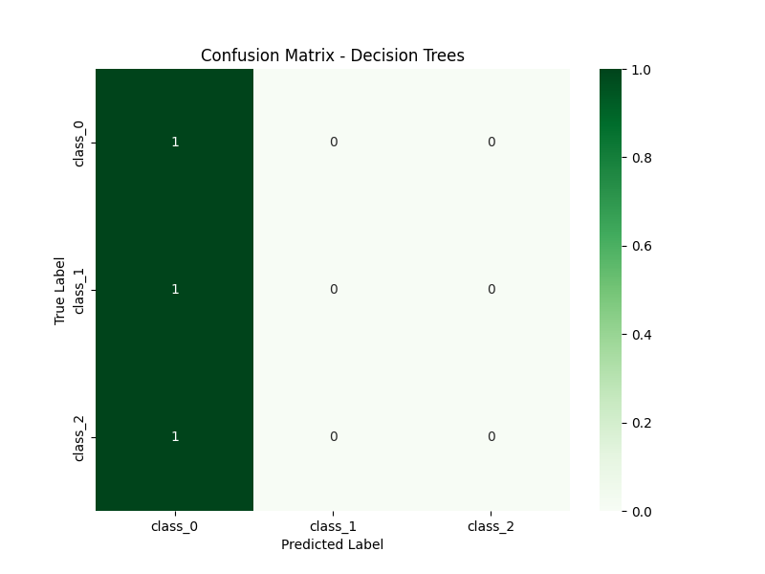
Visualization of the new instance for decision tree

Slide 28
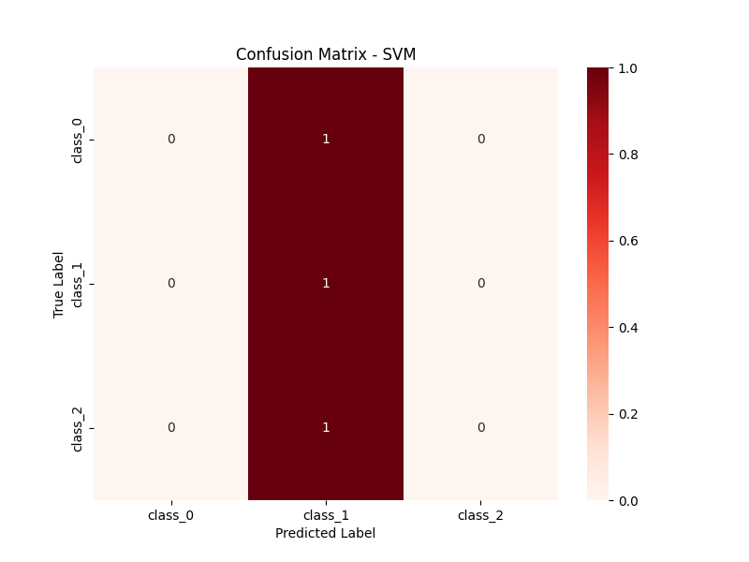
Visualization of the new instance for svm

Slide 29
Exploratory Data Analysis of the wine classification project
Exploratory data analysis (EDA) for the wine classification project involves understanding the dataset's characteristics and relationships between features. Summary statistics provide insights into feature distributions, while visualizations like Pair plots and boxplots help identify patterns and variations across classes. The correlation heatmap reveals feature interactions, guiding feature selection and preprocessing decisions. EDA aids in understanding the dataset's structure, informing model selection and optimization strategies. Overall, EDA facilitates insights into the dataset's properties, enhancing the Modeling process and ensuring robust classification performance.

Slide 30
Summary Statistics
Summary Statistics:
alcohol malic_acid ... proline target
count 178.000000 178.000000 ... 178.000000 178.000000
mean 13.000618 2.336348 ... 746.893258 0.938202
std 0.811827 1.117146 ... 314.907474 0.775035
min 11.030000 0.740000 ... 278.000000 0.000000
25% 12.362500 1.602500 ... 500.500000 0.000000
50% 13.050000 1.865000 ... 673.500000 1.000000
75% 13.677500 3.082500 ... 985.000000 2.000000
max 14.830000 5.800000 ... 1680.000000 2.000000

Slide 31
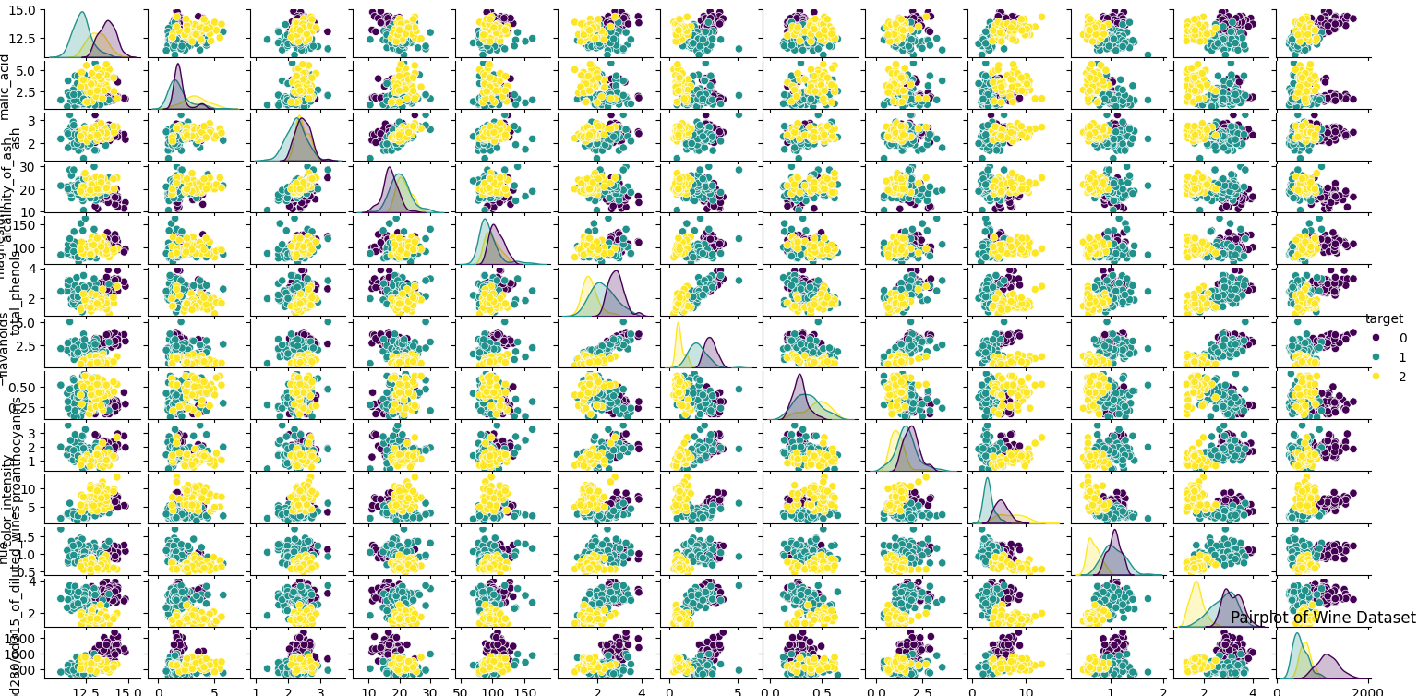
Diagram of exploratory data analysis of the wine classification

Slide 32
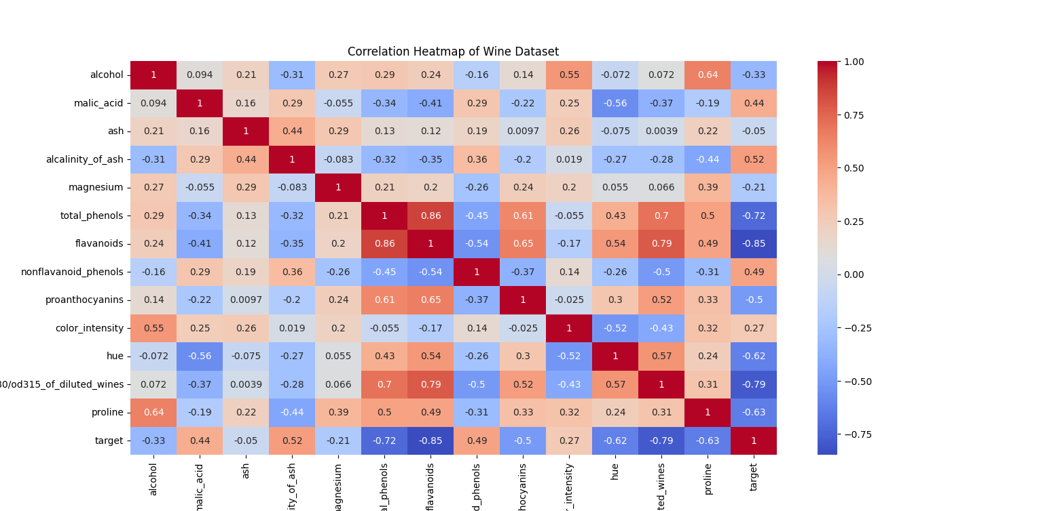
Correlation Heat map of wine datasets

Slide 33
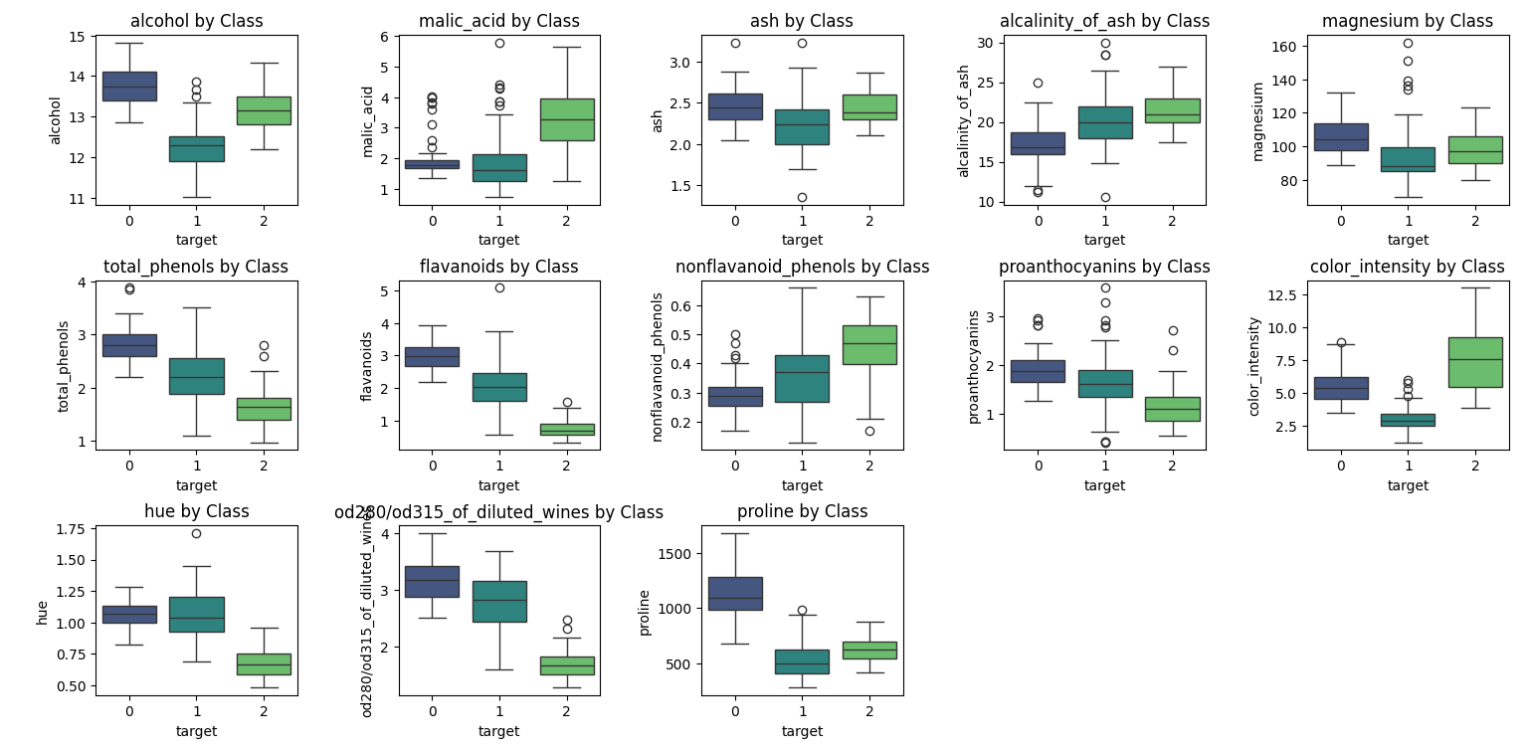
Features vs class

Slide 34
exploratory data analysis (EDA) for the new instances
The exploratory data analysis (EDA) for the new instances involves examining their features to understand their characteristics. Summary statistics provide an overview of the new instances' data distribution, while visualizations like boxplots help identify any outliers or differences compared to the original dataset. Additionally, the correlation heatmap allows us to explore relationships between features within the new instances. EDA aids in assessing the suitability of the new instances for classification tasks and provides insights into their potential impact on model performance. Overall, EDA for the new instances facilitates a deeper understanding of their properties and guides subsequent modeling decisions.

Slide 35
Summary Statistics of New Instances
Summary Statistics of New Instances:
Alcohol Malic Acid ... OD280/OD315 of Diluted Wines Proline
count 3.000000 3.000000 ... 3.000000 3.000000
mean 13.166667 2.333333 ... 2.833333 806.666667
std 1.040833 0.763763 ... 0.152753 253.245599
min 12.000000 1.500000 ... 2.700000 520.000000
25% 12.750000 2.000000 ... 2.750000 710.000000
50% 13.500000 2.500000 ... 2.800000 900.000000
75% 13.750000 2.750000 ... 2.900000 950.000000
max 14.000000 3.000000 ... 3.000000 1000.000000
[8 rows x 13 columns]

Slide 36
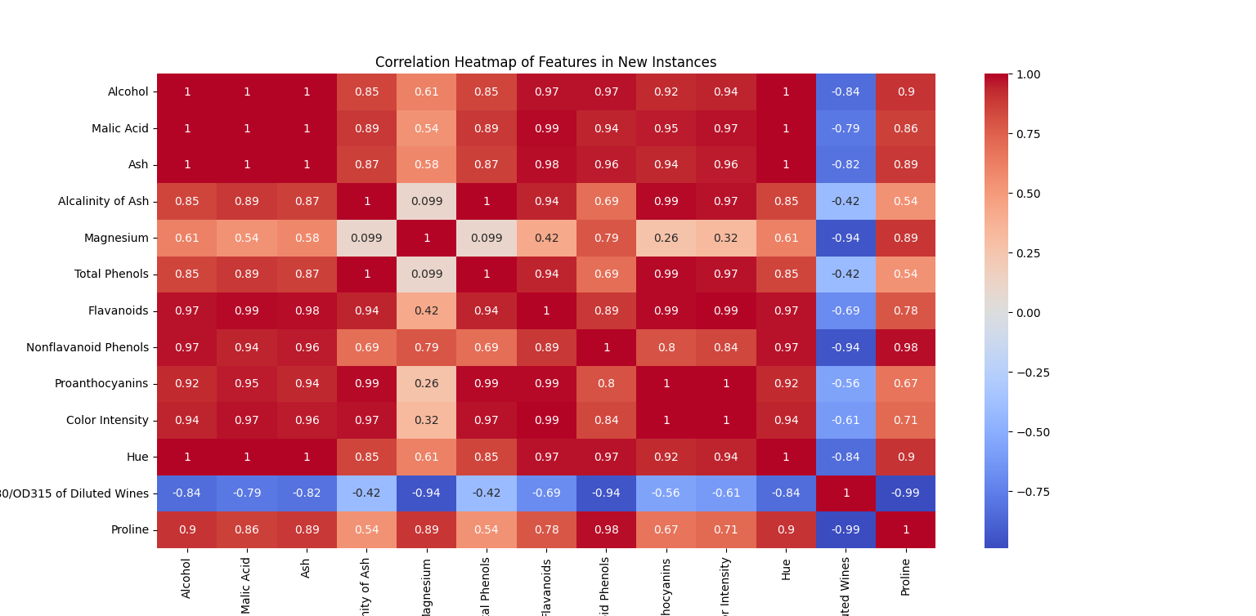
Correlation heat map of new instances

Slide 37
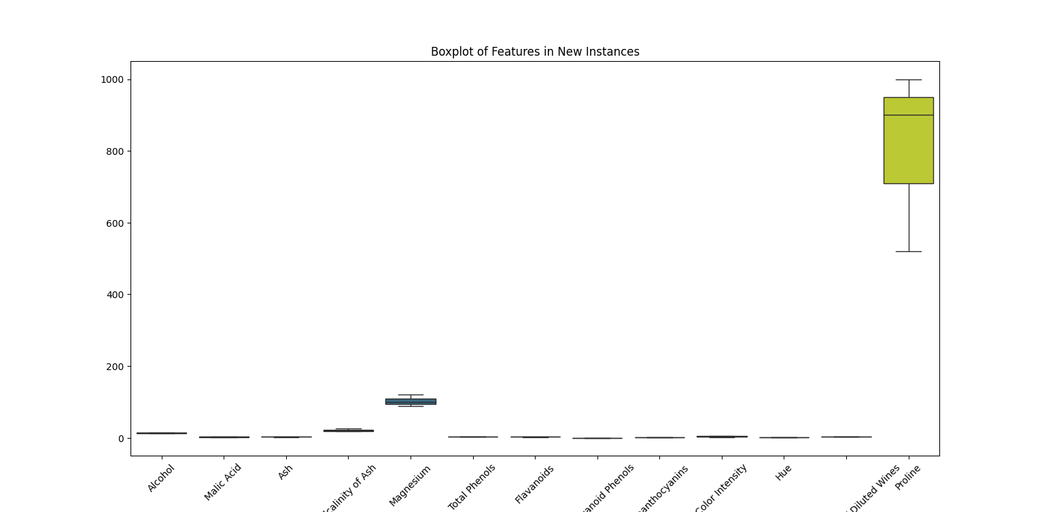
Features in new instances

Slide 38
New instances vs the real wine dataset
The new instances introduced for prediction possess chemical properties akin to those in the original dataset. However, they represent hypothetical scenarios and lack real-world validation. In contrast, the original dataset's visualization depicted empirical data, showcasing actual wine samples with established class labels. While the visualization of the project displayed the distribution of features and class labels, the new instances' visualization solely focuses on the predicted outcomes. Additionally, the original dataset's visualization provided insights into the dataset's structure, feature importance, and decision boundaries, aiding in model interpretation. Conversely, the visualization of the new instances highlights the models' predictive capabilities but lacks the context provided by the original dataset. Despite these differences, both visualizations serve essential roles in understanding the models' performance and their ability to classify wine samples accurately.

Slide 39
New instances vs dataset (eda)
In conclusion, the exploratory data analysis (EDA) provided valuable insights into the characteristics of the original Wine dataset, helping us understand feature distributions, relationships, and potential correlations. This analysis guided our preprocessing steps and model selection, ensuring robust classification models. Additionally, the EDA for the new instances shed light on their features and distributions, aiding in assessing their suitability for classification tasks. Overall, the EDA process facilitated a deeper understanding of both the original dataset and the new instances, guiding our modeling decisions and ensuring the effectiveness of our classification approach.

Slide 40
Challenges face during the projects
Throughout the project, several challenges were encountered, each requiring careful consideration and problem-solving. Initially, understanding the dataset's intricacies and the significance of its features posed a hurdle, particularly when lacking domain-specific knowledge. Subsequently, preprocessing the data involved addressing missing values, outliers, and ensuring appropriate feature scaling, demanding meticulous attention to detail. Model selection proved to be another challenge, as it required choosing suitable classification algorithms and optimizing their hyperparameters through iterative experimentation and evaluation. Interpreting the results of the models, including coefficients in logistic regression and decision boundaries in SVM, required comprehensive analysis and understanding. Additionally, creating meaningful visualizations to convey insights effectively, especially for multidimensional data, demanded creativity and proficiency in visualization techniques. Time management was also critical, necessitating efficient allocation of time to complete the project within the given timeline while ensuring thorough exploration, modeling, and documentation. Lastly, collaboration among team members was vital, requiring effective communication and coordination to divide tasks, share insights, and integrate individual contributions, particularly in remote or virtual settings. Despite these challenges, overcoming them through collaboration, experimentation, and perseverance ultimately led to the successful completion of the project.

Slide 41
Conclusion
In conclusion, our wine classification project has provided valuable insights into the effectiveness of different classification algorithms – logistic regression, decision trees, have gained a comprehensive understanding of each model's strengths and limitations. While logistic regression offers simplicity and interpretability, decision trees excel in providing insights into feature importance and decision-making processes. On the other hand, SVMs demonstrate robust classification capabilities in high-dimensional feature spaces. Comparative analysis of evaluation metrics, including accuracy, precision, recall, and F1 score, has enabled us to make informed decisions regarding model selection and performance. Overall, this project underscores the importance of employing diverse machine learning techniques and thorough evaluation methodologies to address complex classification tasks effectively. Future work may involve exploring ensemble methods and advanced techniques to further improve the accuracy and robustness of wine classification models.

Slide 42



Group members
BERNARD BROWNE
ID NO: 27858
BSc. HONS INFORMATION TECHNOLOGY
YEAR 4
MOHAMED LAMIN CONTEH
ID NO: 27782
BSc. HONS INFORMATION TECHNOLOGY
YEAR 4
SHEKU ALUSINE KEBE
ID NO 29080
BSc. HONS INFORMATION TECHNOLOGY
YEAR 4

Slide 43
THANK YOU

